Slide 1
Defect Classification with Indeterminate Awareness Using Gaussian Process and Cross-Entropy Hybrid Models
For oral defense
Reporter：林怡瑄
Date：114/01/02
Notes:
我的論文主題是Defect Classification with Indeterminate Awareness Using Gaussian Process and Cross-Entropy Hybrid Models
(具備不確定性感知的高斯過程與交叉熵混合模型在瑕疵分類中的應用)

Slide 2
Revise History
Date | Description
2024/11/21 | Initial version
2024/12/06 | Add Research process , overkill rate , leakage rate

Slide 3
Steps in the Research Process
Introduction : Goal , Challenge , Solution
Define the Research Topic and Objectives
Dataset Preparation : PCB dataset
Related works : Gaussian Process,GPCE hybrid model
Foundation Building
Research method : Implement of GPCE hybrid model
Design the Research Methodology
Research Result : learning curve , t-sne visualization , (extended)confusion matrix , evaluation metrics
Conclusion
Conduct Experiments and Gather Results
Notes:
研究的過程中，我先定義研究的主題和目標，這部分會在introduction作介紹，接著藉由準備資料集以及了解背景知識建立好相關的基礎，以GPCE hybrid model的架構推廣到瑕疵分類上作為研究方法，最後通過實驗得到learning curve ,t-sne visualization, confusion matrix, evaluation metrics來驗證及分析最後結果。

Slide 4
CONTENTS
01
Introduction
04
Research Results
02
Related works
05
Conclusion
03
Research Methods
Notes:
接下來的報告，我們分為introduction, related works, research methods, research results, conclusion五個章節來介紹。

Slide 5
Introduction
PART ONE

Slide 6
Part1: Introduction
Goal
Our goal is to refine the architecture of the previously proposed defect detection model in our laboratory, transforming it into a system for defect classification.
The previously proposed defect detection model includes two branches: the upper branch is a cross-entropy-based defect detector, and the lower branch comprises a Gaussian-process-based component classifier and a converter for transforming component classification into defect detection.
Challenge
Although we got good performance on predict the samples good or bad, but we can’t sure that would get good performance on each defect type.
Solution
Replace the binary (good/bad) classifier with a multi-class classifier on the upper branch of the hybrid model.
Combining three independent defect detectors through a one-vs-all classification framework.
Notes:
我們的目標是將之前實驗室在瑕疵檢測提出的GPCE hybrid model改良使其可使用在瑕疵分類上，使我們的模型不單能找出生產出來的不良品將其剔除，還能判斷其為哪一種瑕疵種類，使我們能更容易找出生產過程的問題，雖然在瑕疵檢測上我們提出的模型已取得良好的結果，但我們不確定能不能在瑕疵分類上也得到同樣的提升，因此我們先提出兩種方法來做分析比較，分別是將GPCE hybrid model的upper branch由binary classifier改成4-class classifier以及針對每一個瑕疵種類獨立訓練出defect detector並利用one-vs-all的概念結合三者。

Slide 7
Part1: Introduction
PCB dataset - overview
Number of images | 136,4400
Component types | 35
Defect types | 6 (good, missing, shift,stand,broke,short)
Label information | Each image is labeled with 1 type of component and 1 type of defect.
Table 1.1 : overview of PCB dataset in initial version
Notes:
接下來會使用PCB dataset來做研究與實驗，以下是PCB dataset的介紹，資料集中總共有136萬4400張的圖片，這些圖片可以分為35個元件種類或是6個瑕疵種類，因此每張圖片會各有一個元件種類的標籤及瑕疵種類的標籤。

Slide 8
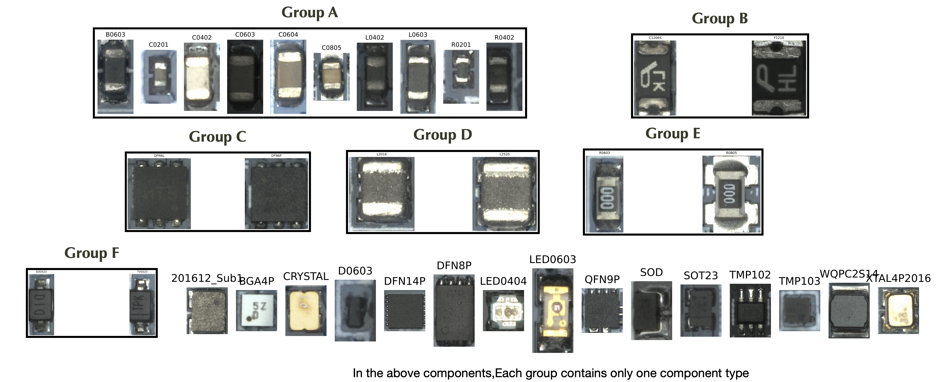
Part1: Introduction
PCB dataset - component regrouping
Notes:
我們會先將元件種類重新做分群，將外觀相似的元件種類組成同一group，避免在訓練時著重在相似元件種類的分類上，造成overfitting的情況。我們將此步驟稱作component regroup

Slide 9
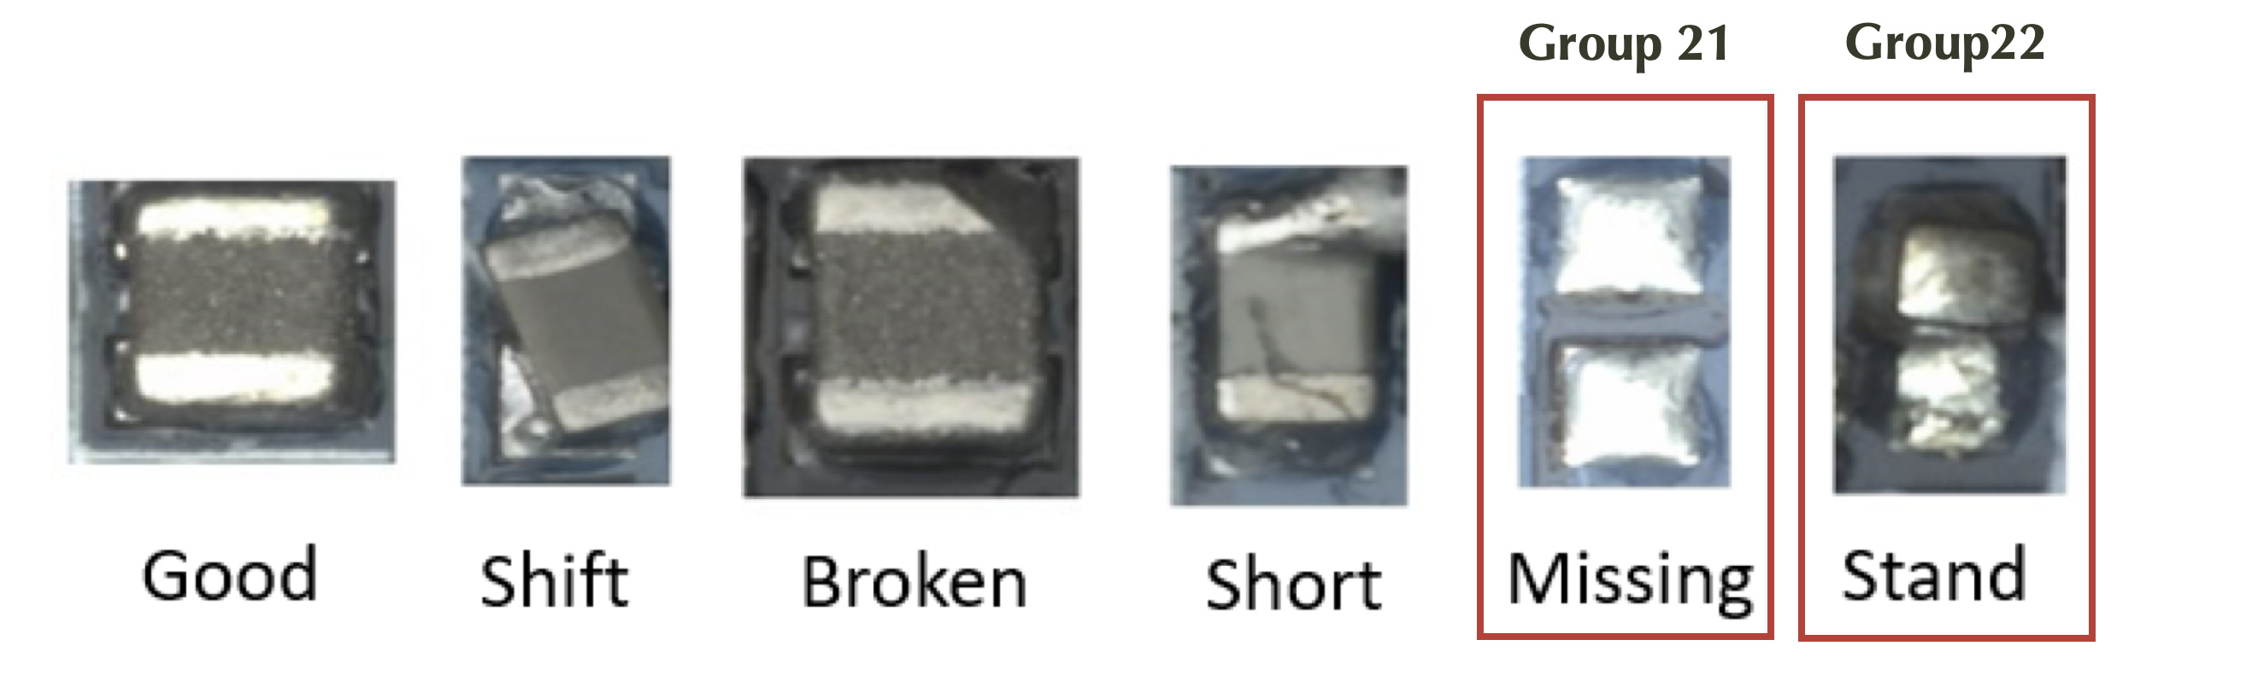
Part1: Introduction
PCB dataset – defect types
Missing and standing samples are difficult to be visually recognized as specific components. We treat them as two separate components.
Notes:
而瑕疵種類的外觀上，因為missing跟stand的外觀跟原先無瑕疵的同樣元件差異較大，使得訓練上無法準確的分類為原元件種類，故我們將這兩種瑕疵種類拉出來當作獨立的元件種類。

Slide 10
Part1: Introduction
PCB dataset - Version for our experiment
Number of images | 219991
Component types | 10
Defect types | 4 (good, shift, broke, short)
Label information | Each image is labeled with 1 type of component and 1 type of defect.
Table 1.2 : overview of PCB dataset in our version
 | Component name relabeling | Component name | Total | good | shift | broke | short
1 | Group A | ['C0604', 'C0201', 'B0603', 'L0402', 'R0402', 'C0805', 'C0603', 'L0603', 'C0402', 'R0201'] | 137641 | 108845 | 11292 | 10513 | 6991
2 | Group B | ['F1210', 'C1206S'] | 9792 | 9704 | 88 | 0 | 0
3 | BGA4P | ['BGA4P'] | 3057 | 2777 | 178 | 102 | 0
5 | CRYSTAL | ['CRYSTAL'] | 6300 | 6078 | 76 | 146 | 0
6 | Group D | ['L2016', 'L2520'] | 37458 | 34294 | 1245 | 1479 | 440
10 | Group E | ['R0805', 'R0603'] | 1679 | 1084 | 449 | 146 | 0
11 | Group F | ['TVS523', 'SOD523'] | 6089 | 5437 | 310 | 342 | 0
14 | QFN9P | ['QFN9P'] | 773 | 767 | 4 | 2 | 0
16 | SOT23 | ['SOT23'] | 12568 | 11542 | 588 | 438 | 0
17 | TMP102 | ['TMP102'] | 4634 | 4196 | 292 | 146 | 0
Table 1.3 : number of each component group in our version
Notes:
整理過後的實驗版本我們共採用了21萬9991張的圖片，10個元件種類跟4個瑕疵種類，下面表格是每個元件種類的瑕疵數量。

Slide 11
Part1: Introduction
Definition of old / new component
Old component
Old components refer to component types that are more prevalent in the training dataset. These components have been part of the training dataset for a longer period, resulting in a larger number of samples, including more good type and defect type samples. Due to their extensive inclusion in the training process, the characteristics and defect detection reliability of these components are well-established and optimized.
New component
New components refer to component types that have been recently added to the training dataset. Since these components were introduced later, the available defect type samples are relatively fewer, potentially leading to less comprehensive training and detection accuracy compared to old components. However, the inclusion of new components helps to expand and update the training dataset, enhancing the model's ability to adapt to the latest technologies and manufacturing processes.
 | Sample availability during training | Sample availability during testing
Old | Normal type samples : many Defect type samples : many | Normal type samples : enough Defect type samples : enough
New | Normal type samples : many Defect type samples : few or none | Normal type samples : enough Defect type samples : enough
Table 1.4 : comparison of old/new component
Notes:
除此之外，我們發現在收集資料集時，有些新開始生產的元件種類不一定都能收集到足夠的瑕疵數量使得訓練時部分元件的瑕疵樣本不足，於是我們這邊將此問題在以下做定義，將元件分為new component與old component兩種，old component指的是已長期在產線中生產，並收集了充足的各瑕疵種類樣本數量，而new component為剛開始加入產線，還沒收集充足的瑕疵樣本數量，數量差異上可以得到以下表格的結果，訓練時的舊元件有充足的normal與defect sample，新元件則有足夠的normal sample但defect sample極少甚至完全沒有，而在測試集中為使實驗足以觀察我們的研究方法在新舊元件的實驗結果。新舊元件都有足夠的normal與defect sample，

Slide 12
Related work
PART TWO

Slide 13
Part2: Related Work
Gaussian process
Gaussian process classifier (conditional inference)
Gaussian process use a latent function to represent the underlying distribution of each class. These functions are distributed according to a multivariate Gaussian distribution, and they allow us to determine the likelihood of the input belonging to a particular class.
Inducing point Gaussian process classifier(prototypical conditional inference)
In the 1st stage of training, we set inducing points to be the same as the number of component types, and then we fix the model parameters of the feature extractor to enhance the training of the gaussian process classifier. We called this as Inducing point Gaussian process classifier.
Converting Gaussian process component-type classifier to defect-type classifier(our previous work)
We utilize the intrinsic property of GP to be able to output both the predicted value and its uncertainty, and apply it to the detection of defective components, and indeterminate the data with too large uncertainty.
Notes:
首先，我們採用了一種基於隨機過程的模型，gaussian process ，在假設每一組輸出都符合gaussian distribution的前提下，gaussian process會定義每筆輸入與其可能輸出值的gaussian distribution，
並以gaussian process在已知樣本的gaussian distribution為條件，推論出新輸入資料的輸出值為何。
我們為了提升訓練的效率，設定inducing point與預測類別的數量相同，使模型可直接以每個元件種類原型的gaussian distribution為條件來做推論，我們將這種prototypical conditional inference稱作inducing point gaussian process classifier，並且在第二階段加強gaussian process classifier訓練時，會將inducing point 增加為預測類別的50倍來提高gaussian process classifier推論的準確性。
最後，我們將gaussian process的probabilities轉換為對瑕疵的偵測。

Slide 14
Part2: Related Work
GPCE-Hybrid model for defect detection (our previous work)
high
high
low
low
Uncertainty
Uncertainty
Expert 1 : binary-class(good/bad) classifier by MLP and cross entropy
Expert 2 : component classifier by gaussian process
Hybrid expert 1 & expert2 and share their feature extractor
high
 | good samples in old component
 | bad samples in old component
 | good samples in new component
 | bad samples in new component
low
Hybrid expert
Uncertainty
Notes:
接下來我們將Gaussian process and cross entropy hybrid model，簡稱為GPCE hybrid model，在defect detection上，GPCE hybrid model的expert1是MLP classifier + cross entropy，若只使用expert1，直接以decision boundary 分類是否有瑕疵，會因為new component 的瑕疵元件不足導致這部分判別結果較差，而expert2是使用gaussian process分類元件種類，在這邊我們只使用good sample訓練，使gaussian process在good sample估計的信心度比較高，而沒看過的瑕疵元件會有較高的不確定性，我們藉由hybrid expert的方式結合expert1與expert2，使得hybrid expert既能判別出瑕疵元件，也能將較高不確定性的元件判為indeterminate。

Slide 15
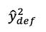
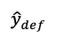

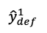
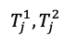
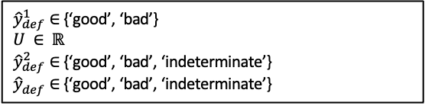
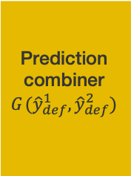
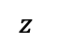
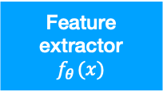
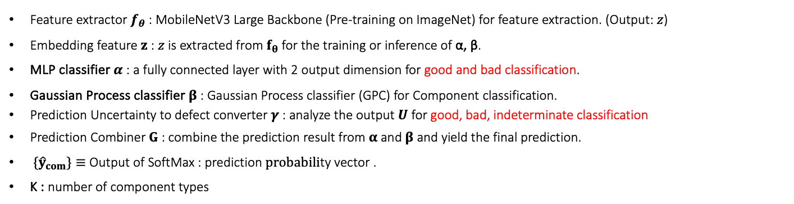
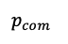

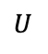
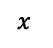
Part2: Related Work
Previously proposed GPCE-Hybrid model(gaussian process and cross entropy hybrid model)
Feature extractor $f_{θ}$ : MobileNetV3 Large Backbone (Pre-training on ImageNet) for feature extraction. (Output: $z$)
Embedding feature $z$ : $z$ is extracted from $f_{θ}$ for the training or inference of α, β.
MLP classifier $α$ : a fully connected layer with 2 output dimension for good and bad classification.
Gaussian Process classifier $β$ : Gaussian Process classifier (GPC) for Component classification.
Prediction Uncertainty to defect converter$γ$: analyze the output $U$ for good, bad, indeterminate classification
Prediction Combiner $G$ : combine the prediction result from$α$ and$β$ and yield the final prediction.
${\{\hat{y}}_{com}\}≡$ Output of SoftMax : prediction $probabili$ty vector .
K : number of component types
${\hat{y}}_{def}^{1}∈$ {‘good’, ‘bad’}
$$U ∈ ℝ$$
${\hat{y}}_{def}^{2}∈$ {‘good’, ‘bad’, ‘indeterminate’}
${\hat{y}}_{def}^{ }∈$ {‘good’, ‘bad’, ‘indeterminate’}
classify to good/bad
MLP classifier
$$α_{ }(z)$$
$${\hat{y}}_{def}^{1}$$
Prediction combiner
$$G_{ }({\hat{y}}_{def}^{1},{\hat{y}}_{def}^{2})$$
$$x_{ }$$
Feature extractor
$$f_{θ_{ }}(x)$$
$$z_{ }$$
$${\hat{y}}_{def}^{ }$$
$$T_{j_{ }}^{1},{T_{j_{ }}^{2}}_{ }$$
Gaussian process classifier
$$β_{ }(z)$$
Probabilities to predict uncertainty converter
predict uncertainty to defect converter
$${p_{com}}_{ }$$
$$U_{ }$$
$${\hat{y}}_{def}^{2}$$
convert to defect detector
Notes:
下圖是GPCE hybrid model的流程，會先經由一個共通的feature extractor提取出樣本特徵，接著分為upper branch使用MLP classifier判別出瑕疵與否作為y^1_def的結果good,bad，lower branch藉由gaussian process classifier對元件的不確定性轉換成瑕疵與否的估計，得到y^2_def的結果為good , bad, indeterminate，最後結合兩者得到最後的y_hat_def。

Slide 16
Research Methods
PART THREE

Slide 17
Part3: Research method
GPCE-Hybrid model for defect classification -
Baseline : Multi-defect-type classifier
Use only the MLP classifier to categorize multi-defect types.
Method 1 : A modified hybrid expert, incorporating both multi-defect-type and multi-component-type classifier In expert1, we implement binary-class (good/bad) MLP classifier into 4-class(good/shift/broke/short) MLP classifier ,such that we can classify multi-defect types.
In Expert 2, we only use good samples for component classification, using the uncertainty of the gaussian process classifier for each component type to determine true/false/indeterminate.
Method 2 : One-vs-all classification framework , 3 hybrid experts (each expert incorporating both single-defect-type and multi-component-type classifier)
Based on the concept of one-vs-all, we train 3 hybrid experts for guided defect detector (shift/not shift, broke/not broke, short/not short) and merge the 3 to get the classification result of defect types.
Notes:
首先在research method我們會先介紹baseline的架構，baseline只使用MLP classifier得到的瑕疵分類結果直接作為最後的判定結果，接著是我們以GPCE hybrid model推廣出的method1及method2，method1是將expert1的binary class MLP classifier改為4-class MLP classifier，使模型可判別出瑕疵的種類，並在expert2分類時只使用good sample做元件分類的gaussian process classifier，利用其估計的不確定性轉換為瑕疵與否的偵測，在method2，我們使用one-vs-all的概念結合三個偵測單一瑕疵種類的hybrid expert得到最後的結果

Slide 18
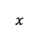
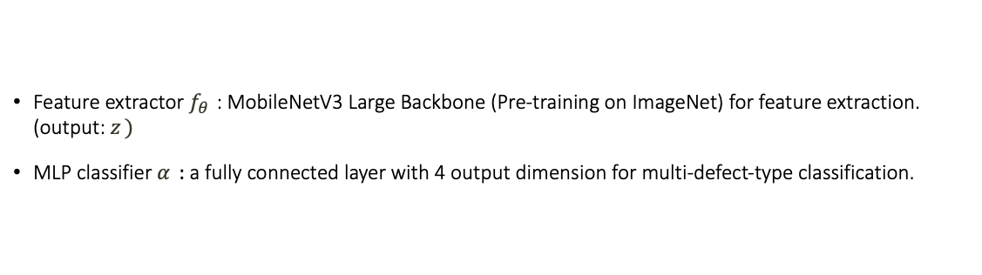
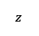
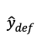
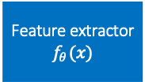
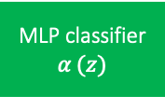
Part3: Research method
Baseline : multi-defect-type classifier
Feature extractor $f_{θ_{ }}$ : MobileNetV3 Large Backbone (Pre-training on ImageNet) for feature extraction. (output: $z_{ })$
MLP classifier $α_{ }$ : a fully connected layer with 4 output dimension for multi-defect-type classification.
$${\hat{y}}_{def}^{ }∈\left\{’good’,’shift’,’broke’,’short’\right\}$$
$$x_{ }$$
Feature extractor
$$f_{θ_{ }}(x)$$
$$z_{ }$$
MLP classifier
$$α_{ }(z)$$
$${\hat{y}}_{def}^{ }$$
Notes:
首先Baseline是經由一個mobile net v3 large的feature extractor提取出樣本的特徵z，再經由一層fully connected layer的MLP classifier輸出瑕疵種類的分類結果(good, shift, broke, short);

Slide 19
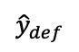
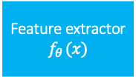
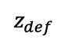
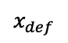
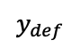
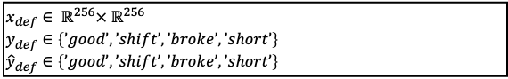
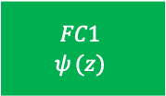
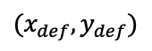
Part3: Research method
training procedure of Baseline
$$x_{def}∈ ℝ^{256}× ℝ^{256}$$
$$y_{def}^{ }∈\left\{’good’,’shift’,’broke’,’short’\right\}$$
$${\hat{y}}_{def}^{ }∈\left\{’good’,’shift’,’broke’,’short’\right\}$$
$$y_{def}$$
$${(x}_{def},y_{def})$$
$$x_{def}$$
Feature extractor
$$f_{θ_{ }}(x)$$
$$z_{def}$$
$$FC1$$
$$ψ_{ }(z)$$
$${\hat{y}}_{def}$$
Cross entropy loss
Notes:
訓練過程中我們會透過cross entropy loss的結果來更新feature extractor與MLP classifier的參數。

Slide 20
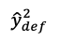
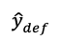

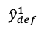
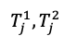
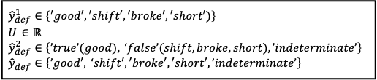
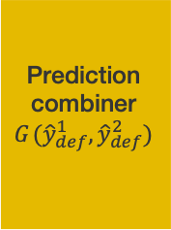
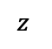
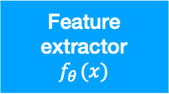
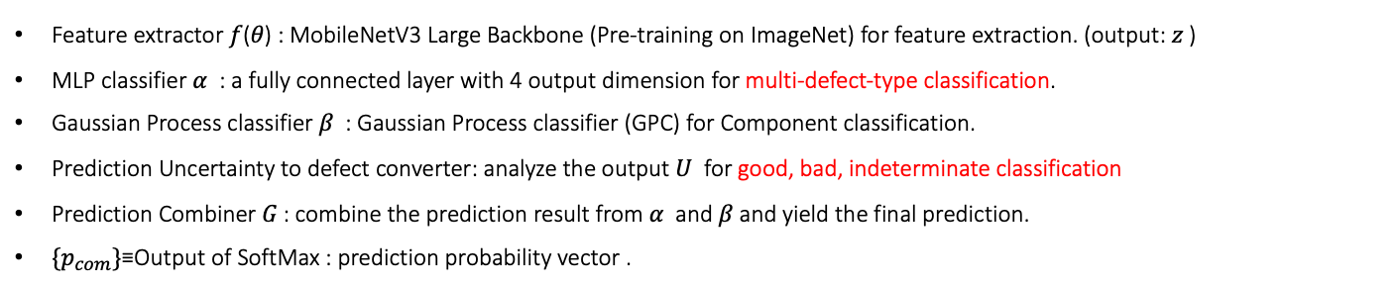
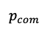
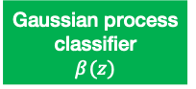
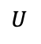
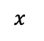
Part3: Research method
Method 1 : a Hybrid Expert, incorporating both Multi-Defect-Type and Multi-Component-Type Classifier
Feature extractor 𝑓(𝜃) : MobileNetV3 Large Backbone (Pre-training on ImageNet) for feature extraction. (output: 𝑧 )
MLP classifier 𝛼 : a fully connected layer with 4 output dimension for multi-defect-type classification.
Gaussian Process classifier 𝛽 : Gaussian Process classifier (GPC) for Component classification.
Prediction Uncertainty to defect converter: analyze the output 𝑈 for good, bad, indeterminate classification
Prediction Combiner 𝐺 : combine the prediction result from 𝛼 and 𝛽 and yield the final prediction.
$\{p_{com}\}$≡Output of SoftMax : prediction probability vector .
$${\hat{y}}_{def}^{1}∈\left\{′good′,′shift′,′broke′,′short′)\right\} \\ U_{ }∈ℝ \\ {\hat{y}}_{def}^{2}∈\left\{’true’(good), ‘false’(shift,broke,short),’indeterminate’\right\} \\ {\hat{y}}_{def}^{ }∈\left\{’good′, ‘shift′,′broke′,′short′,’indeterminate’\right\}$$
classify to good/shift/broke/short
MLP classifier
$$α_{ }(z)$$
$${\hat{y}}_{def}^{1}$$
Prediction combiner
$$G_{ }({\hat{y}}_{def}^{1},{\hat{y}}_{def}^{2})$$
$$x_{ }$$
Feature extractor
$$f_{θ_{ }}(x)$$
$$z_{ }$$
$${\hat{y}}_{def}^{ }$$
$$T_{j_{ }}^{1},{T_{j_{ }}^{2}}_{ }$$
Gaussian process classifier
$$β_{ }(z)$$
Probabilities to predict uncertainty converter
predict uncertainty to defect converter
$${p_{com}}_{ }$$
$$U_{ }$$
$${\hat{y}}_{def}^{2}$$
convert to defect(shift/broke/short) detector
Notes:
method1一樣是以mobile net v3 large作為feature extractor，提取特徵z後，在upper branch上使用MLP classifier判斷出瑕疵的種類 good, shift, broke, short，在lower branch，使用gaussian process classifier在分類元件時估計的probability轉換成瑕疵的偵測結果(true, false, indeterminate)，最後再經由prediction combiner將其整合成最後的結果。

Slide 21
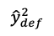
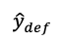
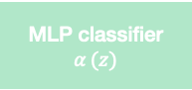
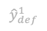
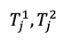
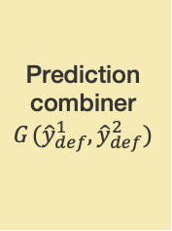
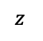
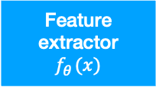
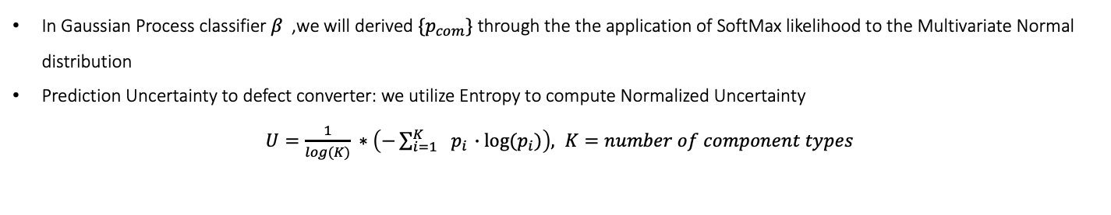



Part3: Research method
Method 1 : a Hybrid Expert, incorporating both Multi-Defect-Type and Multi-Component-Type Classifier
MLP classifier
$$α_{ }(z)$$
$${\hat{y}}_{def}^{1}$$
Prediction combiner
$$G_{ }({\hat{y}}_{def}^{1},{\hat{y}}_{def}^{2})$$
$$x_{ }$$
Feature extractor
$$f_{θ_{ }}(x)$$
$$z_{ }$$
$${\hat{y}}_{def}^{ }$$
$$T_{j_{ }}^{1},{T_{j_{ }}^{2}}_{ }$$
Gaussian process classifier
$$β_{ }(z)$$
Probabilities to predict uncertainty converter
predict uncertainty to defect converter
$${p_{com}}_{ }$$
$$U_{ }$$
$${\hat{y}}_{def}^{2}$$
In Gaussian Process classifier 𝛽 ,we will derived $\{p_{com}\}$ through the the application of SoftMax likelihood to the Multivariate Normal distribution
Prediction Uncertainty to defect converter: we utilize Entropy to compute Normalized Uncertainty
$U=\frac{1}{log(K)} ∗\left(−\sum_{i=1}^{K}{ }{ p}_{i} ∙log⁡(p_{i})\right), K=number of component types$
Notes:
Gaussian process classifier將樣本判定為每個元件種類的probabilities :p_com轉換成uncertainty，我們是採用entropy的公式帶入p_com後再除以log(K)最後得到正規化的uncertainty結果。

Slide 22










Part3: Research method
Method 1 : a Hybrid Expert, incorporating both Multi-Defect-Type and Multi-Component-Type Classifier
MLP classifier
$$α_{ }(z)$$
$${\hat{y}}_{def}^{1}$$
Prediction combiner
$$G_{ }({\hat{y}}_{def}^{1},{\hat{y}}_{def}^{2})$$
$$x_{ }$$
Feature extractor
$$f_{θ_{ }}(x)$$
$$z_{ }$$
$${\hat{y}}_{def}^{ }$$
$$T_{j_{ }}^{1},{T_{j_{ }}^{2}}_{ }$$
Gaussian process classifier
$$β_{ }(z)$$
Probabilities to predict uncertainty converter
predict uncertainty to defect converter
$${p_{com}}_{ }$$
$$U_{ }$$
$${\hat{y}}_{def}^{2}$$
We convert $U$ into ${\hat{y}}_{def}^{2}$ = $\{good, bad, indeterminate\}$by two predefined thresholds $T_{j_{ }}^{1},{T_{j_{ }}^{2}}_{ }$.
We optimize $T_{j_{ }}^{1},{T_{j_{ }}^{2}}_{ }$ by Bayesian optimizer in order to find the best harmonic mean of overkill rate , leakage rate , indeterminate rate
$Harmonic mean=$ $\frac{a+b+c}{\frac{a}{\exp\left(Overkill rate \right)}+\frac{b}{\exp\left(Leakage rate \right)}+\frac{c}{\exp\left(indetertminate rate \right)}} , a=b=c=1$
If $U>T_{j}^{2}$, ${\hat{y}}_{def}^{2}=indeterminate$
If $T_{j}^{2}≥ U>T_{j}^{1}$, ${\hat{y}}_{def}^{2}=false$
If $U≤T_{j}^{1}$, ${\hat{y}}_{def}^{2}=true$
$${\hat{y}}_{def}^{2}$$
good
bad
indeterminate
$$U_{ }$$
0
$$T_{j}^{1}$$
$$T_{j}^{2}$$
1
Notes:
接著再將uncertainty使用threshold T1,T2判斷樣本為true, false, indeterminate，uncertainty大於T2時代表gaussian process classifier對於該樣本不確定性極高，因此判為indeterminate，當uncertainty介於T1,T2中間時，判為false,小於T1時判為true，而threshold我們是使用Bayesian optimizer找出最佳的值。找出overkill , leakage , indeterminate rate的harmonic mean最好的結果

Slide 23

Part3: Research method
Method 1 : Prediction Combiner $G_{ }$ in method1
$defect∈\{shift,broke,short\}$
If ${\hat{y}}_{def}^{1}=good$ and ${\hat{y}}_{def}^{2}=true$ , then ${\hat{y}}_{def}^{ }=good$
Else If ${\hat{y}}_{def}^{1}=defect$ and ${\hat{y}}_{def}^{2}=false$ ,then ${\hat{y}}_{def}^{ }={\hat{y}}_{def}^{1}$
Else if (${\hat{y}}_{def}^{1}=good$ and ${\hat{y}}_{def}^{2}=false$) or (${\hat{y}}_{def}^{1}=defect$ and ${\hat{y}}_{defect}^{2}=true$) or (${\hat{y}}_{def}^{2}=indeterminate$ ), then ${\hat{y}}_{def}^{ }=indeterminate$
Notes:
最後在prediction combiner，若y^1_def判定為good且y^2_def為true時，y_hat_def為good，若y^1_def分類為shift, broke, short其中一種且y^2_def為false時，y_hat_def判為該種defect，若y^1_def與y^2_def結果不一致或y^2_def直接判為indeterminate時，y_hat_def判為indeterminate。

Slide 24























Part3: Research method
training procedure of Method1
Stage1 :
$$y_{def}$$
$${(x}_{def},y_{def})$$
$$x_{def}$$
Feature extractor
$$f_{θ_{ }}(x)$$
$$z_{def}$$
$$FC_{def}$$
$$ψ_{ }(z)$$
$${\hat{y}}_{def}$$
Cross entropy loss
$$y_{com}$$
Share weight
$${(x}_{com},y_{com})$$
$$x_{com}$$
Feature extractor
$$f_{θ_{ }}(x)$$
$$z_{com}$$
$$GP_{com}$$
$$φ_{ }(z)$$
$${\hat{y}}_{com}$$
Variational ELBO
Inducing points = numbers of component type
Stage2 :
$$y_{com}$$
$$x_{def}∈ ℝ^{256}× ℝ^{256}$$
$${\hat{y}}_{def}^{ }∈\left\{’good’,’shift’,’broke’,’short’\right\}$$
$${\hat{y}}_{def}^{ }∈\left\{’good’,’shift’,’broke’,’short’\right\}$$
$$x_{com}∈ ℝ^{256}× ℝ^{256}$$
$${\hat{y}}_{com}^{ }∈\left\{component type1, component type2, …\right\}$$
$${\hat{y}}_{com}^{ }∈\left\{component type1, component type2, …\right\}$$
$${(x}_{com},y_{com})$$
$$x_{com}$$
Feature extractor
$$f_{θ_{ }}(x)$$
$$z_{com}$$
$$GP_{com}$$
$$φ_{ }(z)$$
$${\hat{y}}_{com}$$
Variational ELBO
Inducing points = (numbers of component type) x 50
Notes:
Method1的訓練上使用標記為瑕疵種類的defect training set進行feature extractor與MLP classifier的訓練，並使用cross entropy loss更新模型參數，以及標記為元件種類並且只包含good sample的component training set進行feature extractor與gaussian process classifier的訓練，並使用variational ELBO更新模型參數，進行完第一階段訓練後，我們再第二階段固定feature extractor的參數，將inducing point增加為component type的50倍，繼續更新gaussian process classifier的參數。

Slide 25









Part3: Research method
Method 2 : One-vs-all classification framework : 3 Hybrid Experts, each expert incorporating both Single-Defect-Type and Multi-Component-Type Classifier
$$x$$
GPCE-hybrid model for shift detector
$${\hat{y}}_{shift}$$
Prediction combiner
$$G({\hat{y}}_{shift},{\hat{y}}_{broke},{\hat{y}}_{short})$$
$$x$$
GPCE-hybrid model for broke detector
$${\hat{y}}_{broke}$$
$${\hat{y}}_{ }$$
$$x$$
GPCE-hybrid model for short detector
$${\hat{y}}_{short}$$
$${\hat{y}}_{ }$$
Notes:
在method2，我們利用one-vs-all的概念，分別輸入3個獨立的GPCE hybrid model偵測出shift, broke, short三種瑕疵種類的元件，並將三個結果經由prediction combiner G結合成最後的分類結果

Slide 26














Part3: Research method
Method 2 : GPCE-hybrid model (gaussian process and cross entropy hybrid model) for shift detector
Feature extractor $f_{θ_{1}}$ : MobileNetV3 Large Backbone (Pre-training on ImageNet) for feature extraction. (output: $z_{1})$
MLP classifier $α_{1}$ : a fully connected layer with 2 output dimension for single-defect-type classification.
Gaussian Process classifier $β_{1}$ : Gaussian Process classifier (GPC) for Component classification.
Prediction Uncertainty to defect converter: analyze the output $U_{1}$ for shift, not shift, indeterminate classification
Prediction Combiner $G_{1}$ : combine the prediction result from $α_{1}$ and $β_{1}$ and yield the final prediction.
$\{p_{com1}\}≡$Output of SoftMax : prediction $probabili$ty vector .
$${\hat{y}}_{shift}^{1}∈\left\{’true’(shift), ‘false’(good,broke,short)\right\} \\ U_{1}∈ℝ \\ {\hat{y}}_{shift}^{2}∈\left\{’true’(shift), ‘false’(good,broke,short),’indeterminate’\right\} \\ {\hat{y}}_{shift}^{ }∈\left\{’true’(shift), ‘false’(good,broke,short),’indeterminate’\right\}$$
classify to shift/not shift
MLP classifier
$${α_{1}}_{ }(z)$$
$${\hat{y}}_{shift}^{1}$$
Prediction combiner
$$G_{1}({\hat{y}}_{shift}^{1},{\hat{y}}_{shift}^{2})$$
$$x_{ }$$
Feature extractor
$$f_{{θ_{1}}_{ }}(x)$$
$$z_{ }$$
$$T_{{j_{1}}_{ }}^{1},{T_{j_{ 1 }}^{2}}_{ }$$
$${\hat{y}}_{shift}^{ }$$
Gaussian process classifier
$${β_{1}}_{ }(z)$$
Probabilities to predict uncertainty converter
predict uncertainty to defect converter
$${p_{com1}}_{ }$$
$${U_{1}}_{ }$$
$${\hat{y}}_{shift}^{2}$$
convert to shift detector
Notes:
shift detector的GPCE hybrid model會在upper branch將資料分為shift, 跟不是shift，這邊標籤為true, false，lower branch則利用uncertainty將資料分為true, false, indeterminate，再結合為最後的y_hat_shift

Slide 27












Part3: Research method
Method 2 : GPCE-hybrid model (gaussian process and cross entropy hybrid model) for broke detector
Feature extractor $f_{θ_{2}}$ : MobileNetV3 Large Backbone (Pre-training on ImageNet) for feature extraction. (output: $z_{2})$
MLP classifier $α_{2}$ : a fully connected layer with 2 output dimension for single-defect-type classification.
Gaussian Process classifier $β_{2}$ : Gaussian Process classifier (GPC) for Component classification.
Prediction Uncertainty to defect converter: analyze the output $U_{2}$ for broke, not broke, indeterminate classification
Prediction Combiner $G_{2}$ : combine the prediction result from $α_{2}$ and $β_{2}$ and yield the final prediction.
$\{p_{com2}\}≡$Output of SoftMax : prediction $probabili$ty vector .
$${\hat{y}}_{broke}^{1}∈\left\{’true’(broke), ‘false’(good,shift,short)\right\} \\ U_{2}∈ℝ \\ {\hat{y}}_{broke}^{2}∈\left\{’true’(broke), ‘false’(good,shift,short),’indeterminate’\right\} \\ {\hat{y}}_{broke}^{ }∈\left\{’true’(broke), ‘false’(good,shift,short),’indeterminate’\right\}$$
classify to broke/not broke
MLP classifier
$${α_{2}}_{ }(z)$$
$${\hat{y}}_{broke}^{1}$$
Prediction combiner
$$G_{2}({\hat{y}}_{broke}^{1},{\hat{y}}_{broke}^{2})$$
$$x_{ }$$
Feature extractor
$$f_{{θ_{2}}_{ }}(x)$$
$$z_{ }$$
$$T_{{j_{2}}_{ }}^{1},{T_{j_{ 2 }}^{2}}_{ }$$
$${\hat{y}}_{broke}^{ }$$
Gaussian process classifier
$${β_{2}}_{ }(z)$$
Probabilities to predict uncertainty converter
predict uncertainty to defect converter
$${p_{com2}}_{ }$$
$${U_{2}}_{ }$$
$${\hat{y}}_{broke}^{2}$$
convert to broke detector
Notes:
第二個GPCE hybrid model也會依此整合為y_hat_broke,得到true ,false, indeterminate的結果

Slide 28












Part3: Research method
Method 2 : GPCE-hybrid model (gaussian process and cross entropy hybrid model) for short detector
Feature extractor $f_{θ_{3}}$ : MobileNetV3 Large Backbone (Pre-training on ImageNet) for feature extraction. (output: $z_{3}$)
MLP classifier $α_{3}$ : a fully connected layer with 2 output dimension for single-defect-type classification.
Gaussian Process classifier $β_{3}$ : Gaussian Process classifier (GPC) for Component classification.
Prediction Uncertainty to defect converter: analyze the output $U_{3}$ for shift, not shift, indeterminate classification
Prediction Combiner $G_{3}$ : combine the prediction result from $α_{3}$ and $β_{3}$ and yield the final prediction.
$\{p_{com3}\}≡$Output of SoftMax : prediction $probabili$ty vector .
$${\hat{y}}_{short}^{1}∈\left\{’true’(short), ‘false’(good,shift,broke)\right\} \\ U_{3}∈ℝ \\ {\hat{y}}_{short}^{2}∈\left\{’true’(short), ‘false’(good,shift,broke),’indeterminate’\right\} \\ {\hat{y}}_{short}^{ }∈\left\{’true’(short), ‘false’(good,shift,broke),’indeterminate’\right\}$$
classify to short/not short
MLP classifier
$${α_{3}}_{ }(z)$$
$${\hat{y}}_{short}^{1}$$
Prediction combiner
$$G_{3}({\hat{y}}_{short}^{1},{\hat{y}}_{short}^{2})$$
$$x_{ }$$
Feature extractor
$$f_{{θ_{3}}_{ }}(x)$$
$$z_{ }$$
$$T_{{j_{3}}_{ }}^{1},{T_{j_{ 3 }}^{2}}_{ }$$
$${\hat{y}}_{short}^{ }$$
Gaussian process classifier
$${β_{3}}_{ }(z)$$
Probabilities to predict uncertainty converter
predict uncertainty to defect converter
$${p_{com3}}_{ }$$
$${U_{3}}_{ }$$
$${\hat{y}}_{short}^{2}$$
convert to short detector
Notes:
第三個GPCE hybrid model也會依此整合為y_hat_short,得到true ,false, indeterminate的結果

Slide 29







Part3: Research method
Method 2 : Prediction Combiner $G_{ }$ in method2
If ${\hat{y}}_{shift}^{ }=true$ and ${\hat{y}}_{broke}^{ }=false$ and ${\hat{y}}_{short}^{ }=false$ , then $\hat{y}=shift$
Else If ${\hat{y}}_{shift}^{ }=false$ and ${\hat{y}}_{broke}^{ }= true$ and ${\hat{y}}_{short}^{ }=false$, then $\hat{y}=broke$
Else If ${\hat{y}}_{shift}^{ }=false$ and ${\hat{y}}_{broke}^{ }=false$ and ${\hat{y}}_{short}^{ }=true$ , then $\hat{y}=short$
Else If ${\hat{y}}_{shift}^{ }=false$ and ${\hat{y}}_{broke}^{ }=false$ and ${\hat{y}}_{short}^{ }=false$ , then$\hat{ y}=good$
Else $\hat{y}=indeterminate$
$${\hat{y}}_{shift}^{ }$$
Prediction combiner
$$G_{ }({\hat{y}}_{shift}^{ },{\hat{y}}_{broke}^{ },{\hat{y}}_{short})$$
$${\hat{y}}_{broke}^{ }$$
$${\hat{y}}_{ }$$
$${\hat{y}}_{shift}^{ }∈\left\{’true’\left(shift\right), ‘false’\left(good,broke,short\right),’indeterminate’\right\} \\ {\hat{y}}_{broke}^{ }∈\left\{’true’(broke), ‘false’(good,shift,short),’indeterminate’\right\} \\ {\hat{y}}_{short}^{ }∈\left\{’true’\left(short\right), ‘false’\left(good,shift,broke\right),’indeterminate’\right\} \\ {\hat{y}}_{ }∈\{‘good’,’shift’, ’broke’,’short’,’indeterminate’\}$$
$${\hat{y}}_{short}^{ }$$
Notes:
經由3個GPCE hybrid 我們會得到y_hat_shift, y_hat_broke, y_hat_short的結果再經由最後的prediction combiner G做最後的整合，這裏其中一個defect detector判定為true ,且另外兩個defect detector為false，則判為該種瑕疵，例如在y_hat_shift為true時，y_hat_broke與y_hat_short都要等於false才會判為shift，若在3個GPCE hybrid model皆判定為false，y_hat_def才判為good，

Slide 30

Part4: Research result
Experiment setup
Framework | PyTorch
Backbone | MobileNet V3 Large, pre-trained on ImageNet
Image size | 3 $×$ 224 $×$ 224 ( channel $×$ height $×$ width)
Epoch | 50
Batch size | 128
Learning rate | $$lr_{init}=0.05$$ decay the learning rate at epoch 20, 30, 40
Optimizer | Two independent SGD optimizer were used for updating model parameter. (a) feature extractor $f_{θ1}$, MLP classifier $α$. (b) feature extractor $f_{θ1}$, gaussian process classifier $β$.
Data Augmentation | Training set Random horizontal flip, random vertical flip, color jitter, and random gray scale | Validation set and test set No augmentation
GPU | A single NVIDIA Tesla V100 GPU for each experiment
Table 4.1 : experiment setup
Notes:
接著介紹我們的實驗結果，在實驗設定上我們使用單一顆v100 gpu來做每次的實驗，並使用mobile net v3 large作為backbone，參數依照以下表格設定

Slide 31

Part4: Research result
Learning curve in Baseline
Loss/train
Loss/valid
Notes:
首先是baseline的leaning curve，在validation最後的loss有稍微增加，可以看出最後可能有overfitting的情況出現，

Slide 32

Part4: Research result
Learning curve in Method1
Loss/train
Loss/valid
Notes:
而method1的leaning curve雖然在validation前面收斂的較慢，但最後還是有獲得良好的收斂，

Slide 33

Part4: Research result
Learning curve in shift detector of Method2
Loss/train
Loss/valid

Slide 34

Part4: Research result
Learning curve in broke detector of Method2
Loss/train
Loss/valid

Slide 35

Part4: Research result
Learning curve in short detector of Method2
Loss/train
Loss/valid
Notes:
method2會有3個defect detector的learning curve，可以看出3個detector的訓練都有收斂，

Slide 36

Part4: Research result
T-sne for output of feature extractor in Baseline
c
Notes:
接著我們使用各方法在feature extractor的輸出z來觀察tsne的結果，首先baseline可以看到會有部分瑕疵元件歸類在good的範圍內，

Slide 37
Part4: Research result
T-sne for output of feature extractor in Method1
Notes:
Method1的tsne來看，除了明確分到各瑕疵種類的資料外，也有些瑕疵樣本會圍繞在good樣本的旁邊，這部分也就是在gaussian process classifier得到的結果，

Slide 38
Part4: Research result
T-sne for output of feature extractor in shift detector of Method2

Slide 39
Part4: Research result
T-sne for output of feature extractor in broke detector of Method2

Slide 40
Part4: Research result
T-sne for output of feature extractor in short detector of Method2
Notes:
從method2的3個detector也會得到類似結果。

Slide 41
Part4: Research result
Confusion matrix in Baseline,Method1,Method2
baseline
Method 1
Method 2
Notes:
最後將三個方法的confusion matrix放在一起比較，可以看出method1判錯的資料相較於其他兩個都少很多。

Slide 42

Part4: Research result
Evaluation Metrics
$\text{Error} \text{rate}\text{ : }=\frac{(b+c+d+h+i+n)+(f+k+l+p+q+r)}{(a+g+m+s)+(b+c+d+h+i+n)+(f+k+l+p+q+r)}($the number of incorrect predictions divided by the number of predictions $N_{test}−N_{test}^{unk}$).
Overkill rate : $=\frac{(b+c+d)}{(a+g+m+s)+(b+c+d+h+i+n)+(f+k+l+p+q+r)}$
leakage rate : $=\frac{(f+k+p)}{(a+g+m+s)+(b+c+d+h+i+n)+(f+k+l+p+q+r)}$
indeterminate rate : $\frac{N_{test}^{unk}}{N_{test}} = \frac{(e+j+o+t)}{(a+g+m+s)+(e+j+o+t)+(b+c+d+h+i+n)+(f+k+l+p+q+r)}($The number of test sample predicted to be indeterminate $N_{test}^{unk}$ divided by the total number of test sample $N_{test}$)
predicted actually | good | shift | broke | short | indeterminate
good | a | b | c | d | e
shift | f | g | h | i | j
broke | k | l | m | n | o
short | p | q | r | s | t
Table 4.2 : Evaluation Metrics
Notes:
最後將實驗結果以下列四項指標總結與比較，我們這邊的error rate , overkill rate , leakage rate 都是以不是被判為indeterminate的資料統計出來的，error rate是所有預測錯誤的資料在所有沒被判為indeterminate的資料中的比例，overkill rate是指實際為good卻判定為defect的資料在所有沒被判為indeterminate的資料中的比例，leakage rate是指實際為defect卻判為good的資料在所有沒被判為indeterminate的比例，indeterminate rate是indeterminate與所有資料的比例

Slide 43

Part4: Research result
Comparing the performance between Baseline, Method1, Method2 in all samples
$\text{Baseline}\text{ : }\text{multi}\text{−}\text{defect}\text{−}\text{type} \text{classifier}$
Method1 :a Hybrid Expert, incorporating both Multi-Defect-Type and Multi-Component-Type Classifier
Method2 : 3 Hybrid Experts, each expert incorporating both Single-Defect-Type and Multi-Component-Type Classifier
“-u” : with unknown component types
 | error rate(all) | overkill rate(all) | leakage rate(all) | indeterminate rate(all)
baseline | 3.898%±0.509% | 1.498%±0.374% | 1.868%±0.545% | -
method1-u | 2.303%±0.736% | 0.194%±0.150% | 2.039%±0.559% | 8.989%±1.581%
method1 | 2.293%±0.725% | 0.192%±0.153% | 2.077%±0.565% | 10.732%±1.706%
method2-u | 6.377%±0.410% | 0.034%±0.008% | 6.313%±0.393% | 11.472%±0.132%
method2 | 6.400%±0.432% | 0.033%±0.007% | 6.340%±0.419% | 12.126%±0.550%
Table 4.3 : performance between Baseline, Method1, Method2 in all samples

Slide 44
Part4: Research result
Comparing the performance between Baseline, Method1, Method2 in old component samples
$\text{Baseline}\text{ : }\text{multi}\text{−}\text{defect}\text{−}\text{type} \text{classifier}$
Method1 :a Hybrid Expert, incorporating both Multi-Defect-Type and Multi-Component-Type Classifier
Method2 : 3 Hybrid Experts, each expert incorporating both Single-Defect-Type and Multi-Component-Type Classifier
“-u” : with unknown component types
 | error rate(old) | overkill rate(old) | leakage rate(old) | indeterminate rate(old)
baseline | 1.955%±0.492% | 1.939%±0.495% | 0.004%±0.003% | -
method1-u | 0.479%±0.362% | 0.463%±0.364% | 0.002%±0.003% | 7.553%±2.403%
method1 | 0.493%±0.377% | 0.477%±0.379% | 0.002%±0.003% | 10.323%±2.502%
method2-u | 0.314%±0.112% | 0.087%±0.015% | 0.153%±0.108% | 19.044%±2.357%
method2 | 0.414%±0.100% | 0.087%±0.015% | 0.153%±0.099% | 19.362%±2.218%
Table 4.4 : performance between Baseline, Method1, Method2 in old component samples

Slide 45
Part4: Research result
Comparing the performance between Baseline, Method1, Method2 in new component samples
$\text{Baseline}\text{ : }\text{multi}\text{−}\text{defect}\text{−}\text{type} \text{classifier}$
Method1 :a Hybrid Expert, incorporating both Multi-Defect-Type and Multi-Component-Type Classifier
Method2 : 3 Hybrid Experts, each expert incorporating both Single-Defect-Type and Multi-Component-Type Classifier
“-u” : with unknown component types
 | error rate(new) | overkill rate(new) | Leakage rate(new) | indeterminate rate(new)
baseline | 5.195%±0.440% | 0.382%±0.219% | 3.084%±0.881% | -
method1-u | 3.536%±0.987% | 0.012%±0.012% | 2.637%±0.394% | 9.980%±1.938%
method1 | 3.478%±0.931% | 0.006%±0.005% | 2.703%±0.362% | 11.093%±2.789%
method2-u | 9.840%±0.855% | 0.005%±0.006% | 9.833%±0.850% | 6.482%±1.536%
method2 | 7.379%±1.052% | 0.002%±0.002% | 9.902%±0.916% | 7.379%±1.052%
Table 4.5 : performance between Baseline, Method1, Method2 in new component samples

Slide 46
Part5: conclusion
Method 1 (the modified hybrid expert, incorporating both multi-defect-type and multi-component-type classifier) gets the best performance among Baseline, method 1, method 2
But the worst performance is obtained in method 2,
We hypothesize the following reasons Our dichotomy of categorizing data into specific and non-specific defects may cause the gaussian process classifier to see two types of defects other than specific defects, which may confuse its predictions. The ratio of imbalances in the data will increase significantly, which will also affect the results of the MLP classifiers, and the results of the MLP classifiers will be affected.
Notes:
總結以上結果，在baseline, method1, method2之中，method1我們得到較好的結果，並在method2得到較差的結果，我們進而推測了method2結果不佳的兩個原因，首先在method2每個GPCE hybrid model lower branch的gaussian process classifier我們是使用不是特定瑕疵種類的其他樣本，包含了其餘兩種樣本，而非引用原先只使用good sample的想法，可能混淆了gaussian process對元件的分類
並且在只將資料分為特定瑕疵以及good和另外兩種瑕疵的標籤時，相較於瑕疵偵測的good/bad及瑕疵分類的good/shift/broke/short , imbalance ratio明顯更大很多，使得MLP classifier分類的結果受到影響

Slide 47
Thank You for Watching
Reporter：林怡瑄
Date：114/01/02

